Slide 1
About Me
Ritesh Singh
Sun Certified java Professional
Oracle Certified Database Administrator
Certified Ethical Hacker
Certified EC-Council Instructor (CEI)

Slide 2
Course Overview
Introduction to MySQL EXISTS operator

Slide 3
Introduction to MySQL EXISTS operator
The EXISTS operator is a Boolean operator that returns either true or false. The EXISTS operator is often used to test for the existence of rows returned by the subquery.

Slide 4
The following illustrates the basic syntax of the EXISTS operator:
SELECT
select_list
FROM
a_table
WHERE
[NOT] EXISTS(subquery);
If the subquery returns at least one row, the EXISTS operator returns true, otherwise, it returns false.

Slide 5
In addition, the EXISTS operator terminates further processing immediately once it finds a matching row, which can help improve the performance of the query.
The NOT operator negates the EXISTS operator. In other words, the NOT EXISTS returns true if the subquery returns no row, otherwise it returns false.
Note that you can use SELECT *, SELECT column, SELECT a_constant, or anything in the subquery. The results are the same because MySQL ignores the select list appeared in the SELECT clause.

Slide 6
MySQL EXISTS operator examples
Let’s take some examples of using the EXISTS operator to understand how it works.
MySQL SELECT EXISTS examples
Consider the following customers and orders tables in the sample database.

Slide 7
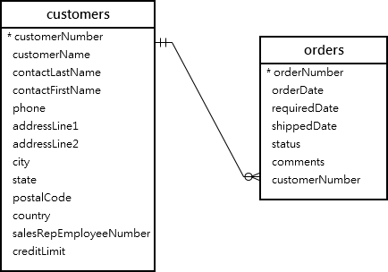

Slide 8

The following statement uses the EXISTS operator to find the customer who has at least one order:
SELECT
customerNumber,
customerName
FROM
customers
WHERE
EXISTS(
SELECT
1
FROM
orders
WHERE
orders.customernumber
= customers.customernumber);

Slide 9
In this example, for each row in the customers table, the query checks the customerNumber in the orders table. If the customerNumber, which appears in the customers table, exists in the orders table, the subquery returns the first matching row. As a result, the EXISTS operator returns true and stops examining the orders table. Otherwise, the subquery returns no row and the EXISTS operator returns false.

Slide 10
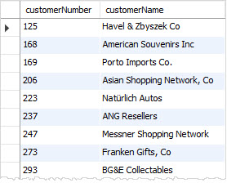
The following example uses the NOT EXISTS operator to find customers who do not have any orders:
SELECT
customerNumber,
customerName
FROM
customers
WHERE
NOT EXISTS(
SELECT
1
FROM
orders
WHERE
orders.customernumber = customers.customernumber
);

Slide 11
MySQL UPDATE EXISTS examples
Suppose that you have to update the phone’s extensions of the employees who work at the office in San Francisco.
The following statement finds employees who work at the office in San Franciso:

Slide 12
SELECT
employeenumber,
firstname,
lastname,
extension
FROM
employees
WHERE
EXISTS(
SELECT
1
FROM
offices
WHERE
city = 'San Francisco' AND
offices.officeCode = employees.officeCode);

Slide 13
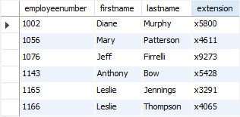

Slide 14
This example adds the number 1 to the phone extension of employees who work at the office in San Francisco:
UPDATE employees
SET
extension = CONCAT(extension, '1')
WHERE
EXISTS(
SELECT
1
FROM
offices
WHERE
city = 'San Francisco'
AND offices.officeCode = employees.officeCode);

Slide 15
How it works.
First, the EXISTS operator in the WHERE clause gets only employees who works at the office in San Fransisco.
Second, the CONCAT() function concatenate the phone extension with the number 1.

Slide 16
MySQL INSERT EXISTS example
Suppose that you want to archive customers who don’t have any sales order in a separate table. To do this, you use these steps:
First, create a new table for archiving the customers by copying the structure from the customers table:
CREATE TABLE customers_archive
LIKE customers;

Slide 17
Second, insert customers who do not have any sales order into the customers_archive table using the following INSERT statement.
INSERT INTO customers_archive
SELECT *
FROM customers
WHERE NOT EXISTS(
SELECT 1
FROM
orders
WHERE
orders.customernumber = customers.customernumber
);

Slide 18
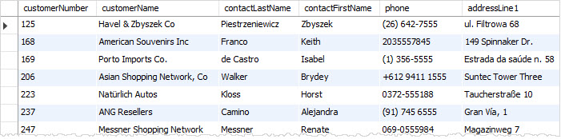
Third, query data from the customers_archive table to verify the insert operation.
SELECT * FROM customers_archive;

Slide 19
MySQL DELETE EXISTS example
One final task in archiving the customer data is to delete the customers that exist in the customers_archive table from the customers table.
To do this, you use the EXISTS operator in WHERE clause of the DELETE statement as follows:
DELETE FROM customers
WHERE EXISTS(
SELECT
1
FROM
customers_archive a
WHERE
a.customernumber = customers.customerNumber);

Slide 20
MySQL EXISTS operator vs. IN operator
To find the customer who has placed at least one order, you can use the IN operator as shown in the following query:
SELECT
customerNumber,
customerName
FROM
customers
WHERE
customerNumber IN (
SELECT
customerNumber
FROM
orders);

Slide 21
Let’s compare the query that uses the IN operator with the one that uses the EXISTS operator by using the EXPLAIN statement.
EXPLAIN SELECT
customerNumber,
customerName
FROM
customers
WHERE
EXISTS(
SELECT
1
FROM
orders
WHERE
orders.customernumber = customers.customernumber);

Slide 22
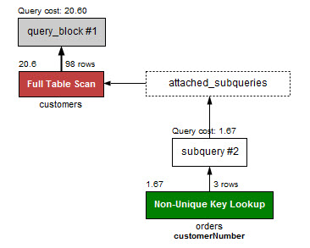

Slide 23
Now, check the performance of the query that uses the IN operator.
SELECT
customerNumber, customerName
FROM
customers
WHERE
customerNumber IN (SELECT
customerNumber
FROM
orders);

Slide 24
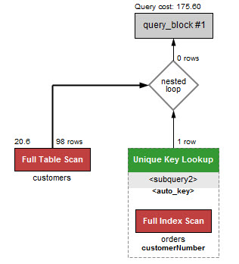

Slide 25
The query that uses the EXISTS operator is much faster than the one that uses the IN operator.
The reason is that the EXISTS operator works based on the “at least found” principle. The EXISTS stops scanning the table when a matching row found.
On the other hands, when the IN operator is combined with a subquery, MySQL must process the subquery first and then uses the result of the subquery to process the whole query.
The general rule of thumb is that if the subquery contains a large volume of data, the EXISTS operator provides better performance.
However, the query that uses the IN operator will perform faster if the result set returned from the subquery is very small.

Slide 26
For example, the following statement uses the IN operator selects all employees who work at the office in San Francisco.
SELECT
employeenumber,
firstname,
lastname
FROM
employees
WHERE
officeCode IN (SELECT
officeCode
FROM
offices
WHERE
offices.city = 'San Francisco');

Slide 27
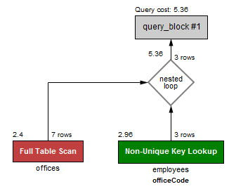
Let’s check the performance of the query.

Slide 28
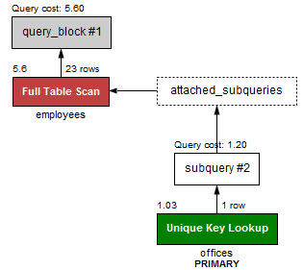
It is a little bit faster than the query that uses the EXISTS operator that we mentioned in the first example. See the performance of the query that uses the EXIST operator below:

Slide 29
Thank You
Please Subscribe My Channel
https://www.youtube.com/channel/UCYW3PWPOPn3qgxxjhUbXXXg?view_as=subscriber

